Slide 1
METU EE7566 Electric Drives in Electric and Hybrid Electric Vehicles
10 – PMSM Drive
Emine Bostancı
Office: C-107

Slide 2
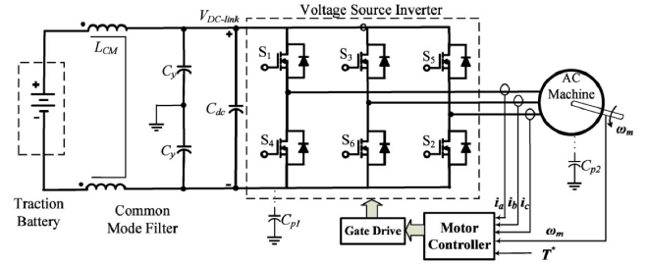
IPMSM Drive System
Inverter
Voltage source inverter (VSI) modulation techniques
Inverter sizing
Motor controller
Field oriented control
Measurements

Slide 3
Modulation Techniques
Sinusoidal Pulse Width Modulation (Sine-PWM)
Space Vector Pulse Width Modulation (SV-PWM)
Better voltage utilization
Lower harmonic content

Slide 4
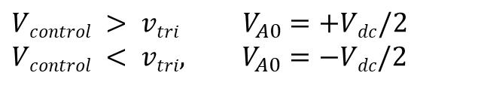
1. Sinusoidal Pulse Width Modulation (Sine-PWM)
$$Vcontrol > vtri{ V}_{A0}=+Vdc/2$$
$$Vcontrol < vtri, V_{A0}=−Vdc/2$$

Slide 5
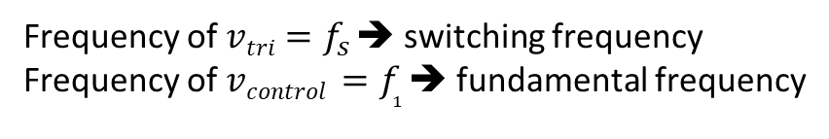
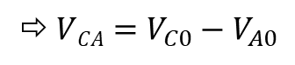
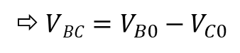
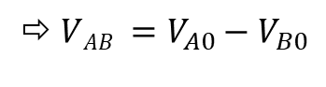
1. Sine-PWM
$VAB =V_{A0}−V_{B0}$
$VBC=V_{B0}−V_{C0}$
$VCA=V_{C0}−V_{A0}$
Frequency of $vtri{=f}_{s}$➔ switching frequency
Frequency of $vcontrol {=f}_{1}$➔ fundamental frequency

Slide 6
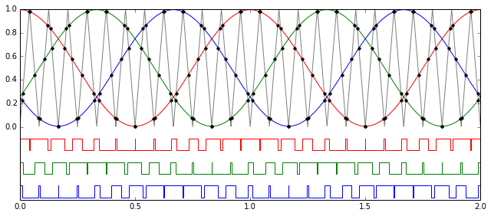
1. Sine-PWM

Slide 7
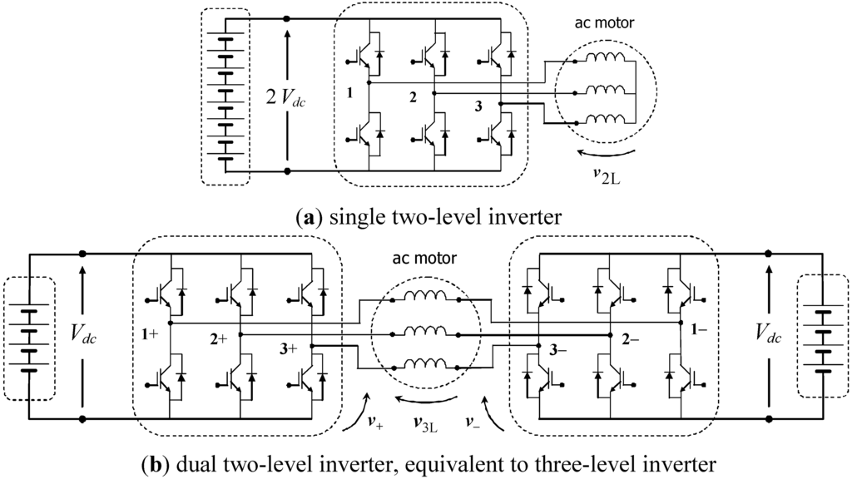
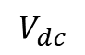
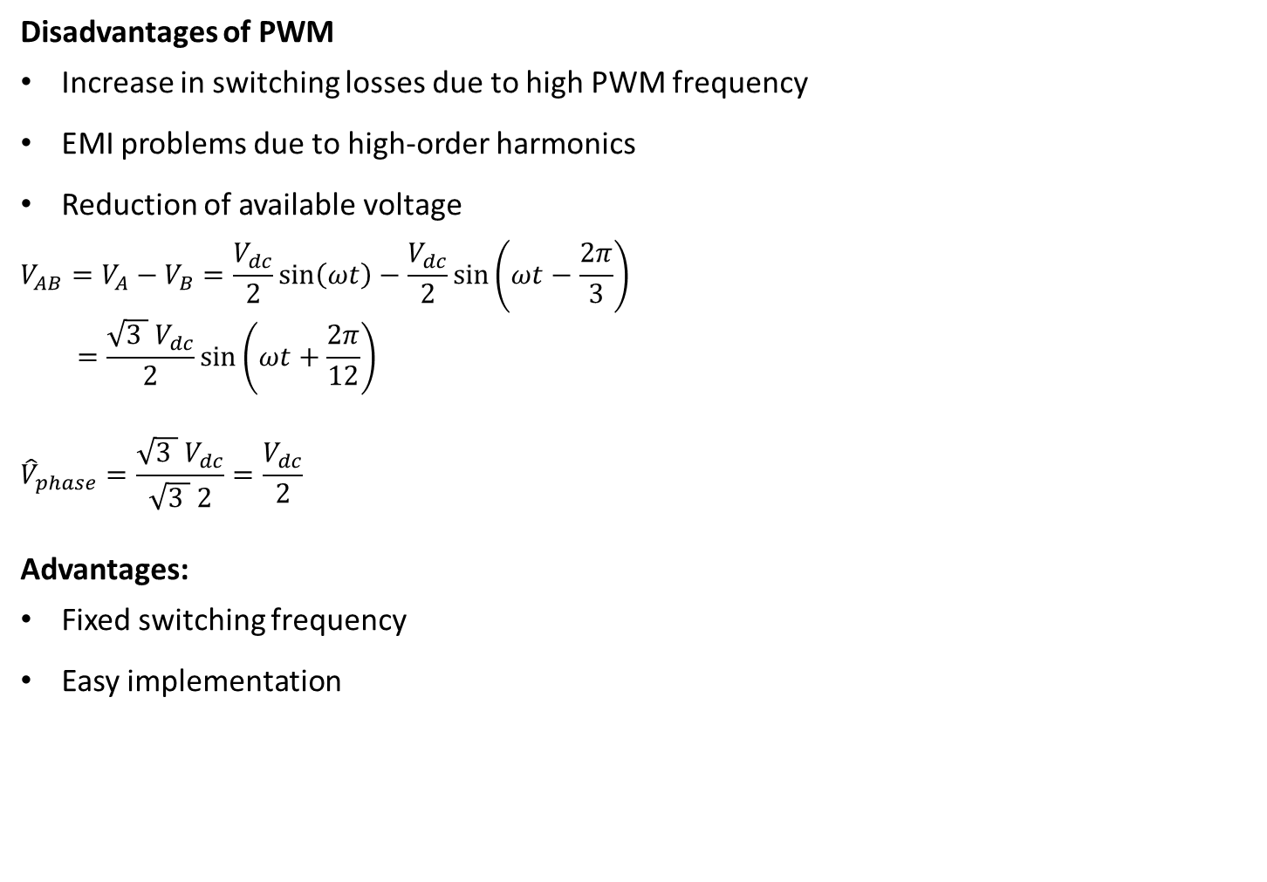
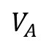
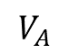
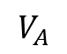
1. Sine-PWM
Disadvantages of PWM
Increase in switching losses due to high PWM frequency
EMI problems due to high-order harmonics
Reduction of available voltage
$$V_{AB}=V_{A}−V_{B}=\frac{V_{dc}}{2}\sin\left(ωt\right)−\frac{V_{dc}}{2}\sin\left(ωt−\frac{2π}{3}\right)$$
$$=\frac{{\sqrt{3 } V}_{dc}}{2}\sin\left(ωt+\frac{2π}{12}\right)$$
$${\hat{V}}_{phase}=\frac{{\sqrt{3 } V}_{dc}}{\sqrt{3 } 2}=\frac{V_{dc}}{2}$$
Advantages:
Fixed switching frequency
Easy implementation
+
$$V_{dc}$$
$$V_{A}$$
$$V_{A}$$
$$V_{A}$$
-
Ω

Slide 8
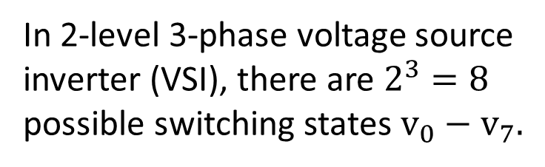
2. Space Vector Pulse Width Modulation
In 2-level 3-phase voltage source inverter (VSI), there are $2^{3}=8$ possible switching states $v_{0}−v_{7}.$

Slide 9
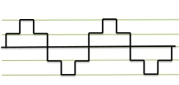
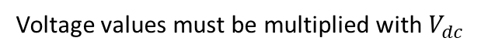
2. Space Vector Pulse Width Modulation
2/3
1/3
Output of switching states, line to neutral (no PWM applied)
Voltage values must be multiplied with $V_{dc}$

Slide 10
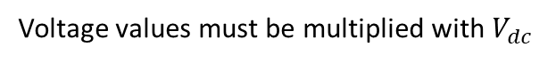
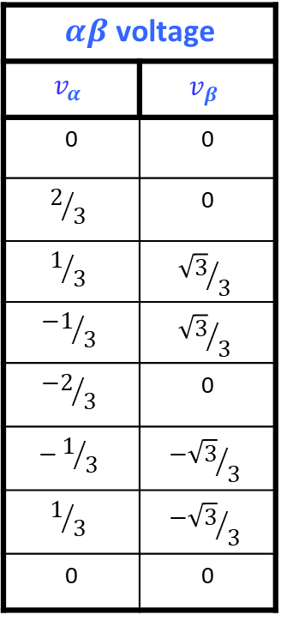
2. Space Vector Pulse Width Modulation
$αβ$ voltage
$$v_{α}$$ | $$v_{β}$$
0 | 0
$$2/3$$ | 0
$$1/3$$ | $${\sqrt{3}}/3$$
$${−1}/3$$ | $${\sqrt{3}}/3$$
$${−2}/3$$ | 0
$$−1/3$$ | $${−\sqrt{3}}/3$$
$$1/3$$ | $${−\sqrt{3}}/3$$
0 | 0
Voltage values must be multiplied with $V_{dc}$

Slide 11
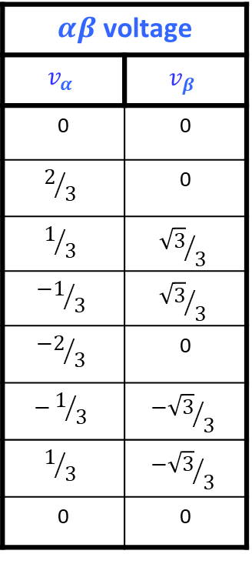
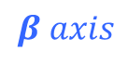
2. Space Vector Pulse Width Modulation
$αβ$ voltage
$$v_{α}$$ | $$v_{β}$$
0 | 0
$$2/3$$ | 0
$$1/3$$ | $${\sqrt{3}}/3$$
$${−1}/3$$ | $${\sqrt{3}}/3$$
$${−2}/3$$ | 0
$$−1/3$$ | $${−\sqrt{3}}/3$$
$$1/3$$ | $${−\sqrt{3}}/3$$
0 | 0
$$β axis$$

Slide 12
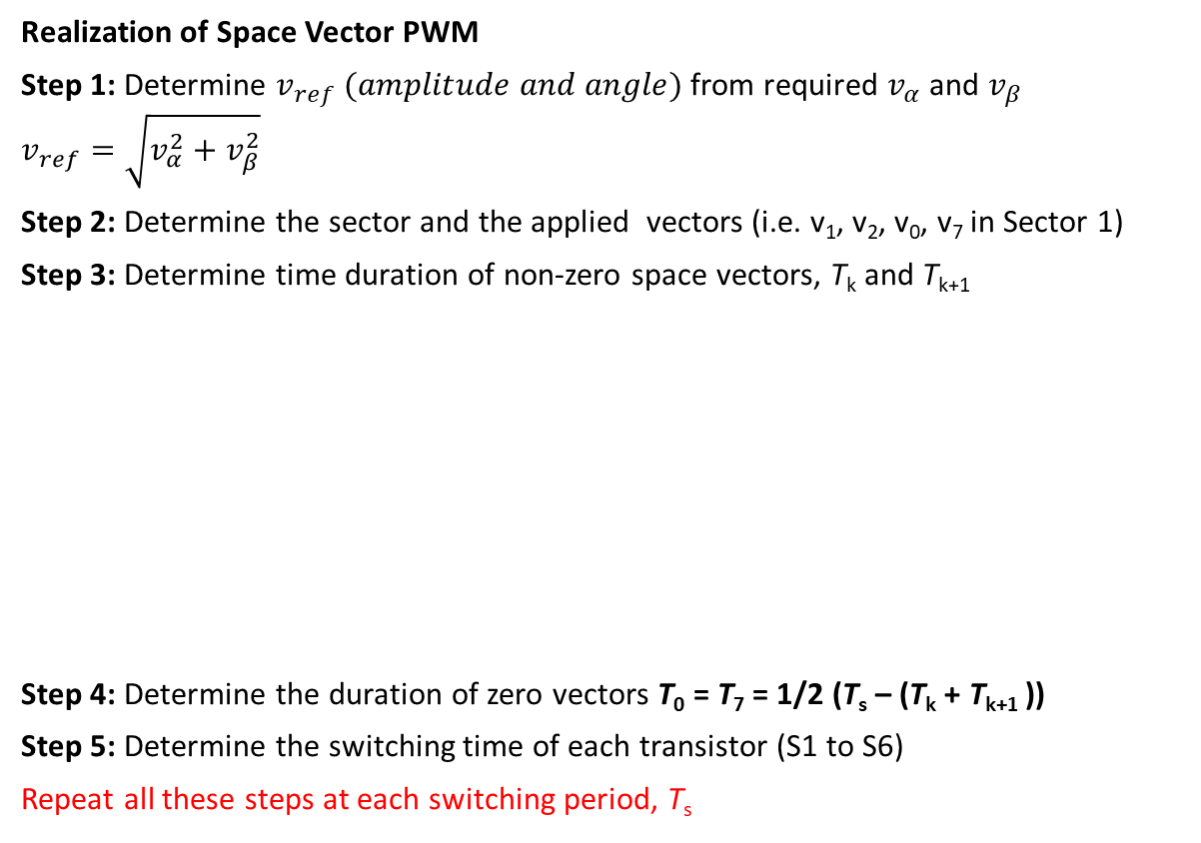
2. Space Vector Pulse Width Modulation
Realization of Space Vector PWM
Step 1: Determine $v_{ref} (amplitude and angle)$ from required $v_{α}$ and $v_{β}$
$$v_{ref}=\sqrt{v_{α}^{2}+v_{β}^{2}}$$
Step 2: Determine the sector and the applied vectors (i.e. v₁, v₂, v₀, v₇ in Sector 1)
Step 3: Determine time duration of non-zero space vectors, T_{k} and T_{k+1}
Step 4: Determine the duration of zero vectors T₀ = T₇ = 1/2 (T_{s} – (T_{k} + T_{k+1} ))
Step 5: Determine the switching time of each transistor (S1 to S6)
Repeat all these steps at each switching period, T_{s}

Slide 13
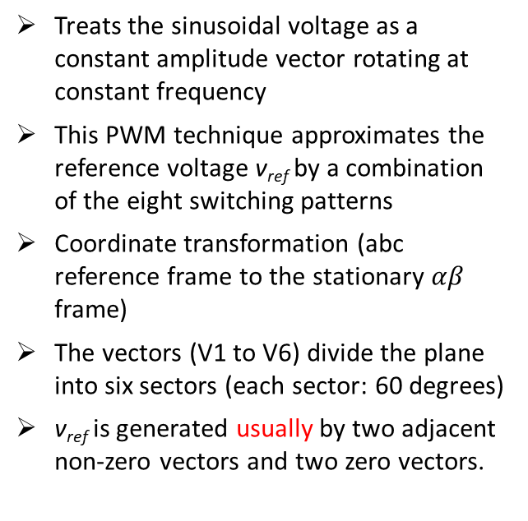
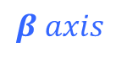

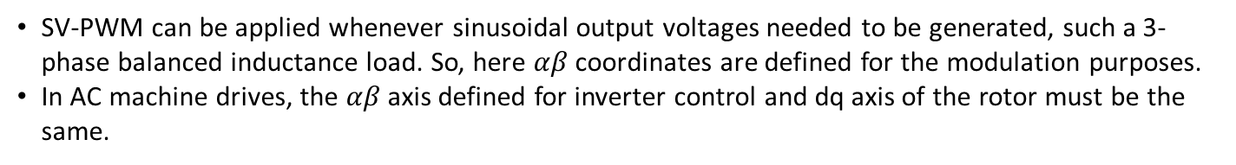
2. Space Vector Pulse Width Modulation
$$β axis$$
Treats the sinusoidal voltage as a constant amplitude vector rotating at constant frequency
This PWM technique approximates the reference voltage v_{ref} by a combination of the eight switching patterns
Coordinate transformation (abc reference frame to the stationary $αβ$ frame)
The vectors (V1 to V6) divide the plane into six sectors (each sector: 60 degrees)
v_{ref} is generated usually by two adjacent non-zero vectors and two zero vectors.
$$α axis$$
SV-PWM can be applied whenever sinusoidal output voltages needed to be generated, such a 3-phase balanced inductance load. So, here $αβ$ coordinates are defined for the modulation purposes.
In AC machine drives, the $αβ$ axis defined for inverter control and dq axis of the rotor must be the same.

Slide 14
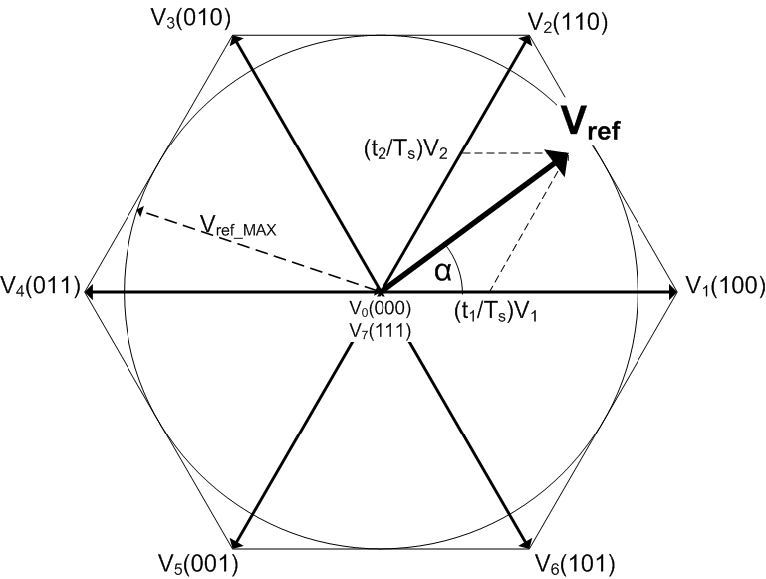
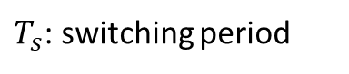
2. Space Vector Pulse Width Modulation
$T_{s}$: switching period
Sequence of the space vectors and the choice of zero vectors influence the number of switching (switching losses) and voltage harmonics.
Scheme shown above is usually employed.

Slide 15
2. Space Vector Pulse Width Modulation
Sector 1
Sector 2
Sector 3
Sector 4
Sector 5
Sector 6

Slide 16


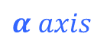
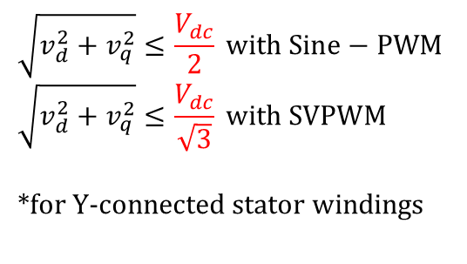
Actual Utilizable Voltage
$$β axis$$
q
$$α axis$$
d
$$\sqrt{v_{d}^{2}+v_{q}^{2}}≤\frac{V_{dc}}{2} with Sine−PWM$$
$$\sqrt{v_{d}^{2}+v_{q}^{2}}≤\frac{V_{dc}}{\sqrt{3}} with SVPWM$$
*for Y-connected stator windings
Forbidden zones: The values either of T_{k} or of T_{k+1} become very small in the boundary zone between the sectors or near one of the non-zero vectors v₁-v₆.
N.P. Quang and J.-A. Dittrich, Vector Control of Three-Phase AC Machines, Power Systems

Slide 17
Difference of Sine-PWM and SV-PWM
S1
States in sector 1 with Sine-PWM
t
S3
t
S5
t
v₀
v₁
v₂
v₇
States in sector 1 with SV-PWM
Sine-PWM minimizes the number of switching.
Sine-PWM and the usually applied SV-PWM have the same sequences.
Difference is the timings of zero-states, T₀ ≠ T₇

Slide 18
Difference of Sine-PWM and SV-PWM
3-phase reference voltages with Sine-PWM
3-phase reference voltages with SV-PWM

Slide 19
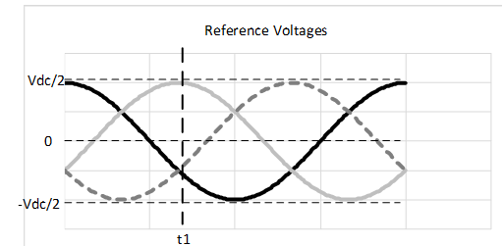

Slide 20
Dead Time in VSI
When an upper switch is turned on
a, b or c is “1”
the corresponding lower switch is turned off
a', b' or c' is “0”
However, finite turn-on and turn-off times of power switches must be considered.
Dead-time
https://www.maximintegrated.com/en/app-notes/index.mvp/id/4266

Slide 21
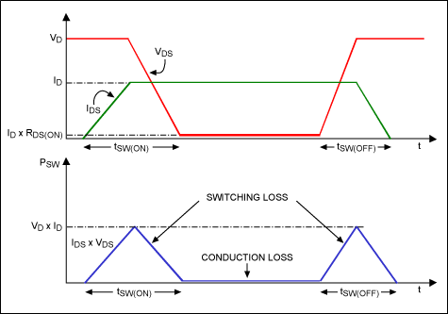
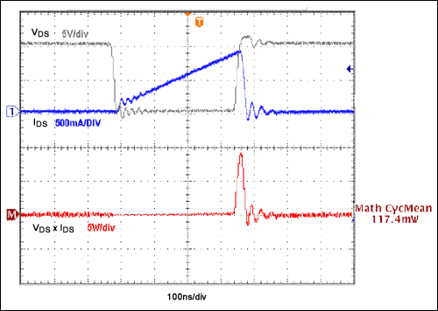
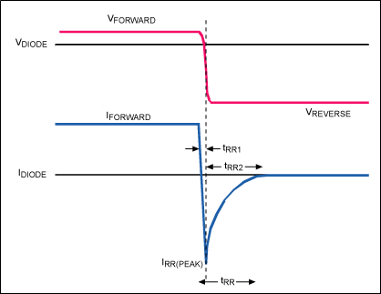
Dead Time in VSI
Switching and switching losses
Turn-off of a diode
https://www.maximintegrated.com/en/app-notes/index.mvp/id/4266

Slide 22
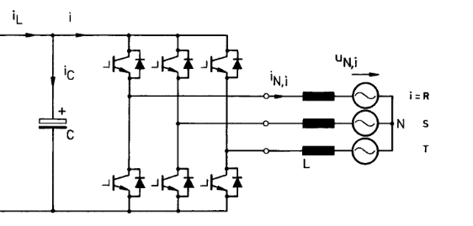
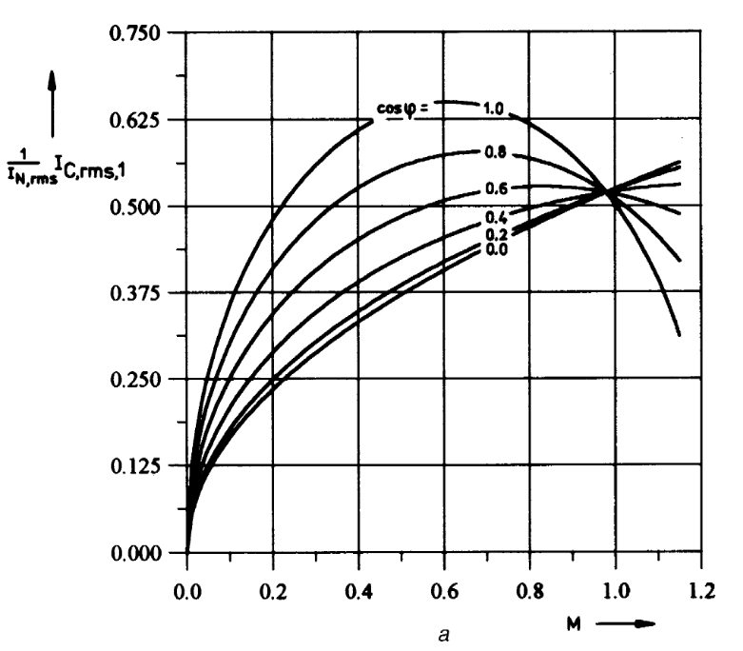
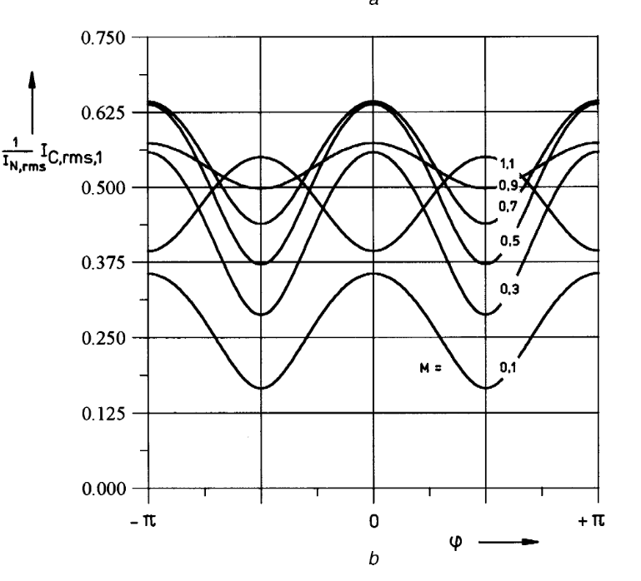
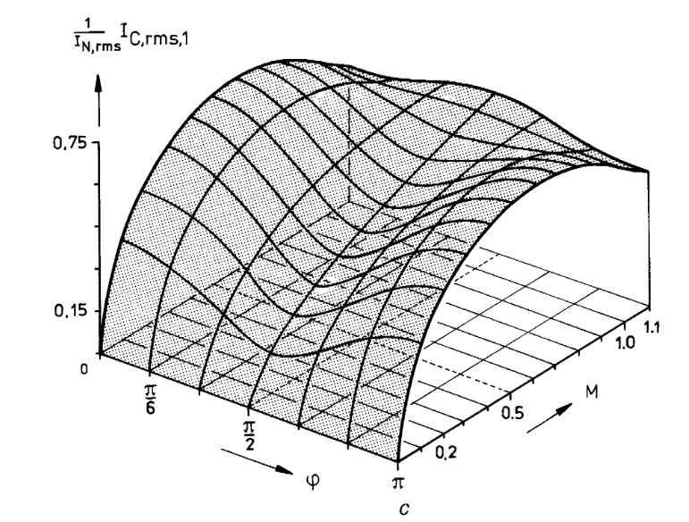
DC-Link Capacitor Current
https://citeseerx.ist.psu.edu/viewdoc/download?doi=10.1.1.483.1080&rep=rep1&type=pdf

Slide 23
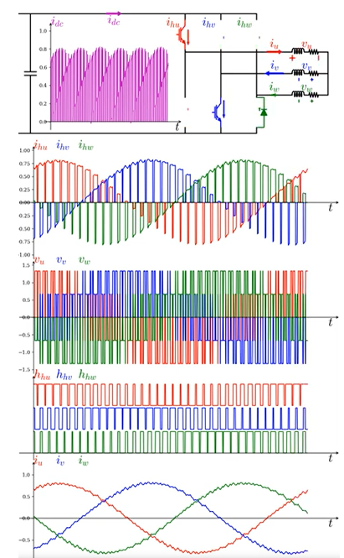
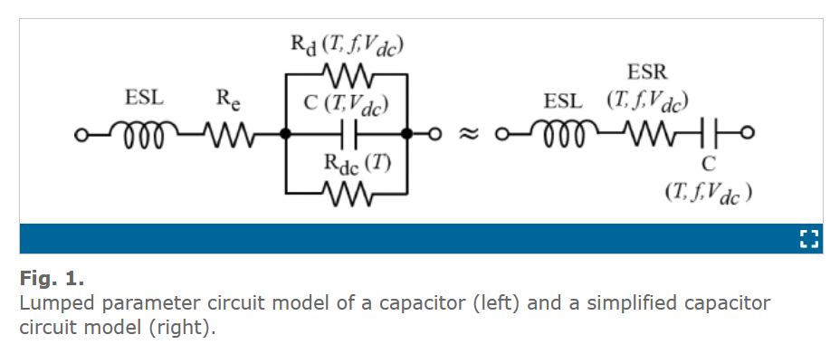
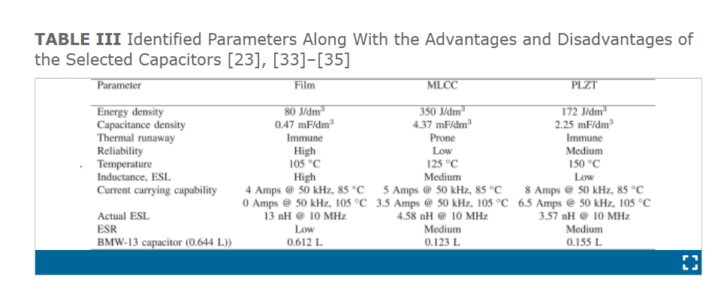
DC-Link Capacitor
Capacitor Technologies: Characterization, Selection, and Packaging for Next-Generation Power Electronics Applications
https://www.youtube.com/watch?v=lwha1p2lnPA

Slide 24
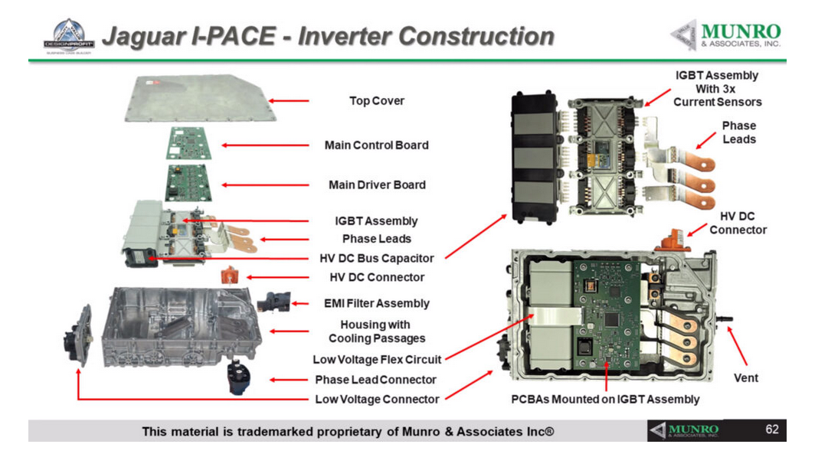
DC-Link Capacitor
https://vasa.org.au/munro-associates-report-details-the-ins-and-outs-of-ev-inverters/

Slide 25
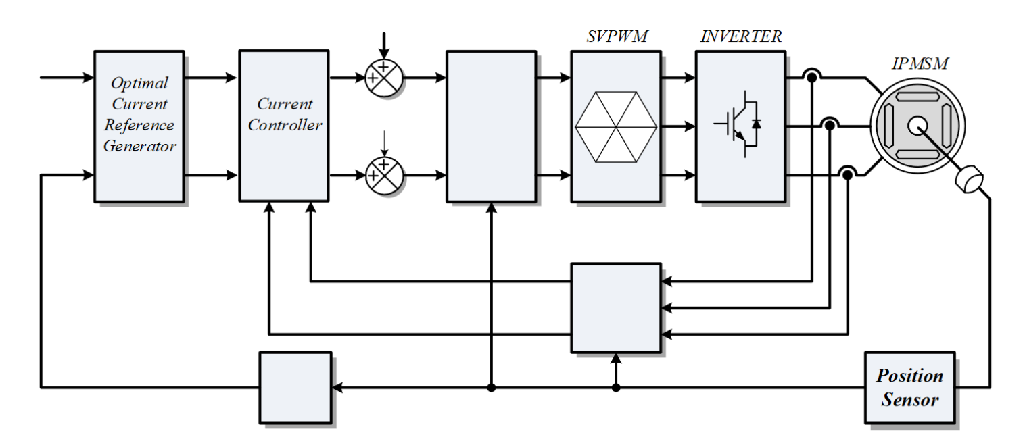
Motor Controller
Field oriented control
Measurements

Slide 26
FOC of a Synchronous Machine

Slide 27
FOC of a Synchronous Machine

Slide 28
Measurements
DC-link voltage
At least 2 of 3 phase currents
Position & speed
Position Measurement & Estimation
Absolute position sensor
Resolvers – Variable reluctance (VR ) resolvers
Sensorless or self-sensing position
High frequency signal injection
Model based position estimators

Slide 29
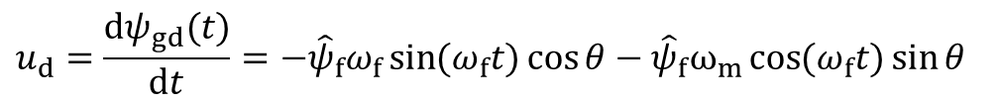
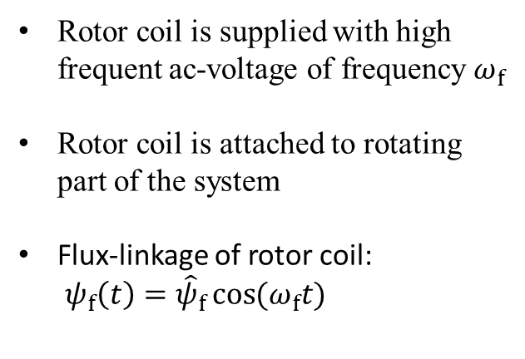
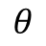
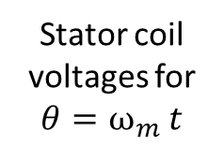
Resolvers
Rotor coil is supplied with high frequent ac-voltage of frequency $ω_{f}$
Rotor coil is attached to rotating part of the system
Flux-linkage of rotor coil:
$ψ_{f}\left(t\right)={\hat{ψ}}_{f}\cos{(ω_{f}t)}$
$$θ$$
Dependent on the rotor position $θ$the induced flux-linkage in the air-gap varies:
$${\vec{ψ}}_{gap}\left(t\right)=ψ_{f}\left(t\right)e^{jθ}=ψ_{gd}+jψ_{gq}={\hat{ψ}}_{f} cos\left(ω_{f}t\right) cos θ+j{\hat{ψ}}_{f}cos\left(ω_{f}t\right)\sin{θ for {θ=ω}_{m}t}$$
$$u_{d}=\frac{dψ_{gd}(t)}{dt}={−\hat{ψ}}_{f}ω_{f}\sin{(ω_{f}t)}\cos{θ}−{\hat{ψ}}_{f}ω_{m}\cos{(ω_{f}t)}\sin{θ}$$
Stator coil voltages for
$$θ=ω_{m} t$$
$$u_{q}=\frac{dψ_{gq}(t)}{dt}={−\hat{ψ}}_{f}ω_{f}\sin{(ω_{f}t)}\sin{θ}+{\hat{ψ}}_{f}ω_{m}\cos{(ω_{f}t)}\cos{θ}$$

Slide 30
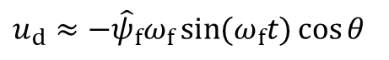
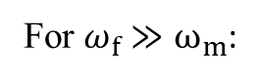
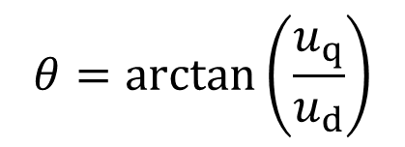
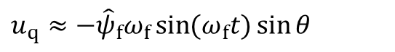
Absolute Position Encoder
Resolver
Rotor coil is supplied with high frequent ac-voltage of frequency $ω_{f}$
Rotor coil is attached to rotating part of the system
Flux-linkage of rotor coil:
$ψ_{f}\left(t\right)={\hat{ψ}}_{f}\cos{(ω_{f}t)}$
$$θ$$
For $ω_{f}≫ω_{m}$:
$$u_{d}≈{−\hat{ψ}}_{f}ω_{f}\sin{(ω_{f}t)}\cos{θ}$$
$$θ=\arctan\left(\frac{u_{q}}{u_{d}}\right)$$
$$u_{q}≈{−\hat{ψ}}_{f}ω_{f}\sin{(ω_{f}t)}\sin{θ}$$
Absolute position detection possible!

Slide 31
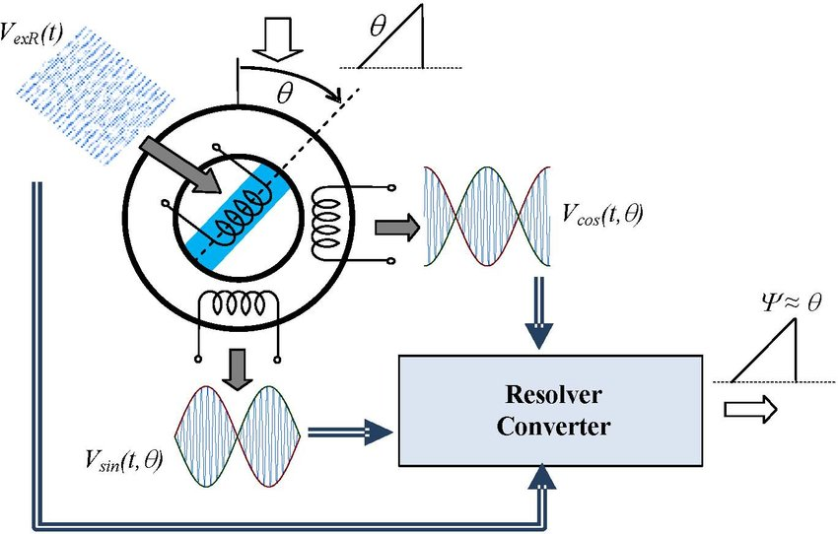
Resolvers
https://www.researchgate.net/publication/261154821_A_novel_resolver_converter_based_on_a_modified_tracking_method

Slide 32

Resolvers
https://learnchannel-tv.com/drives/servomotor/resolver/

Slide 33


VR Resolvers
https://www.minebeamitsumi.com/english/strengths/column/resolver/

Slide 34
Current EM Technology in EVs
Electric machine types
Voltage levels
Power, speed and torque specs
Winding technology
Materials
Cooling systems

Slide 35
Current VSI Technology in EVs
Switches
Capacitors
Frequency

Slide 36
References
Pulse-Width Modulation (PWM) Techniques, Prof. Ali Keyhani
2nd Chapter of N.P. Quang and J.-A. Dittrich, Vector Control of Three-Phase AC Machines, Power Systems
Analytical calculation of the RMS current stress on the DC-link capacitor of voltage-PWM converter systems
https://citeseerx.ist.psu.edu/viewdoc/download?doi=10.1.1.483.1080&rep=rep1&type=pdf
Field-Oriented Control with Simulink, Part 1: What Is Field-Oriented Control?

Slide 37
PMSM Drive Characteristics and Constraint Curves
https://www.mathworks.com/help/mcb/ug/pmsm-characteristics-constraint-curves.html#PMSMDriveCharacteristicsAndConstraintCurvesExample-2
DC-link current analysis of three-phase 2L-VSI considering AC current ripple
https://ietresearch.onlinelibrary.wiley.com/doi/10.1049/iet-pel.2017.0133

Slide 38
Projects
Group of two students, report in IEEE journal format, 15 min presentation
Motors
Effects of materials: Selection PMs, electrical steel, insulation material
Stranded vs. hairpin windings
Inductance, resistance, loss calculation
Multi-phase motors
Contactless exciter for rotor excitation
Inverters
Modulation of two level inverters: THD, Dead Time Effects
DC-link sizing for 2-level inverters
Three-level inverters: Modulation, losses, THD
Pros and cons of using SiC devices
Chargers
AC charger
DC fast charging
Wireless power transfer
Control
Fault

Slide 39

IPMSM for Electric Vehicles
Peak power | 150 kW
Peak torque | 275 Nm
Max. speed | 18000 rpm
Voltage DC-Link | 800 V
OP-BS
[275, 5200]
OP-MS
[80, 18000]
Assumptions:
Rotor geometry | Single V-shape
Number of poles | 8
Core material | 27PNX1350F
Yield strength | 430 MPa
PM material | N48 - H
Slot fill factor | 45%
Air-gap | 1.12 mm
Stator outer rad. | 210 mm
Design requirements:
Mechanical strength at 18000 rpm
Torque and power capability at OP-BS & OP-MS
Radial size limits

Slide 40

IPMSM for Electric Vehicles
Vectorized multi-objective genetic algorithm
# of geometric variables | 7
Population number | 120
Generation number | 8
Optimization objectives
Torque at OP-BS [275 Nm, 5200 rpm] | Set axial length
Axial length | Minimize
Torque at OP-MS | Maximize
Current density${\left(J−20\right)}^{2}$ | Minimize
Torque ripple | Evaluate

Slide 41
Pareto-front of the 150-kW IPMSM, Conductor per slot=4
Pareto-front of the 150-kW IPMSM, Conductor per slot=4.5

Slide 42


Selected IPMSM Design
Parameter | Value
$$R_{rotor}$$ | 73.8 mm
$$dm$$ | 5.84 mm
$$wm_{pu}$$ | 0.85
$$γ$$ | 41 deg
$$α_{v}$$ | 110 deg
flux ratio | 1.3
slot thickness | 4.8 mm
axial length | 140 mm
conductors per slot | 4.5
Air-gap length | 1.1 mm
Current density | 20 A/mm²
Outer stator diameter | 211.5 mm

Slide 43



Selected IPMSM Design
Fillet1: 2.5 mm
Fillet2: 1.5 mm

Slide 44
Analysis with Maxwell Machine Toolkit
Machine Toolkit Settings
Machine Type | PM Synchronous
Number of Poles | 8
Number of Stator Phases | 3
Voltage Control | Line-Line RMS Voltage
Control Strategy | MTPA
Line-line RMS Voltage [V] | 538 (800*0.95/sqrt(2)) - SVPWM
RMS Line Current [A] | 200 (282/sqrt(2))
Connection Type | Wye
Simulation Mode | Motor
Maximum Speed [rpm] | 18000
Phase Resistance [Ohm] | 0.0359
End Winding Inductance [mA] | 0.02
Friction Losses [W] | 23.266
Windage Losses [W] | 23.266
Reference Speed for Losses [rpm] | 5200

Slide 45





Slide 46



Slide 47


PM Demagnetization

